Slide 1
Notes:
Please see the guidance document for important and helpful information before planning to use this presentation.

Slide 2
Introduction
Insert Name, Job Title
Insert program name, school, organization, etc.
Notes:
Introduction slide for the presenter.
Especially for a parent-focused presentation, please introduce yourself and your role.

Slide 3
Agenda
Why we are here
Vaping 101
Vaping policies and procedures
What we can do
Questions/Discussion
Next Steps
Additional Resources
Notes:
You can adjust the agenda according to your needs. Feel free to add additional sections or take away sections that may not be relevant for your meeting.
If your time is limited, please see the presentation guidance document for suggested content to cover.

Slide 4
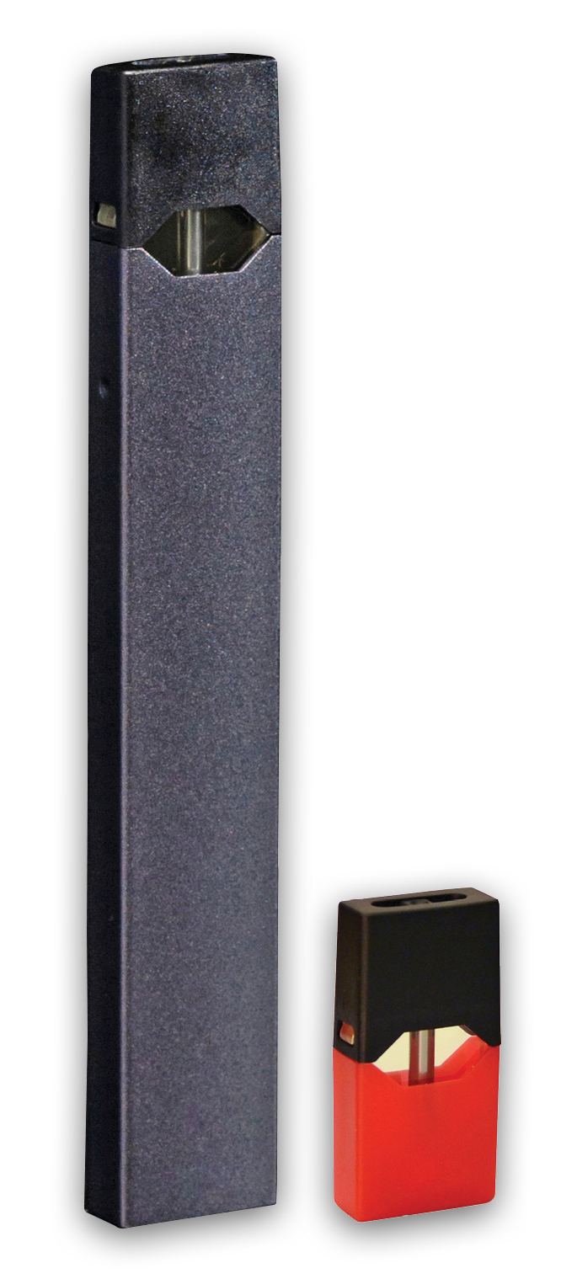
Why are we here?
We care about our youth
To learn about e-cigarettes and other vaping products
To learn about our policies and procedures on vaping and vaping products
To learn about resources to help youth quit
Notes:
Talking Points:
We all know cigarettes are harmful to our health, but what about new and emerging products such as e-cigarettes and other vaping devices? We must educate ourselves about this emerging trend to protect our kids from the influence of the tobacco and vaping industries. We all care about our youth.
Today/tonight, we are here to learn more about these products, what they look like, why they are harmful, our policies and procedures with regard to them, and resources to help youth who might be addicted to them.
In July 2018 Massachusetts Department of Public Health launched a campaign – The New Look of Nicotine Addiction – to educate parents, schools, and adults about the dangers of vaping devices and associated products. It’s about time we Get Outraged!
In April 2019 the Department of Public Health launched a campaign focused on educating youth about these products – we’ll discuss that later in this presentation.

Slide 5
WE Care about our Youth
Youth use of e-cigarettes and the effect of nicotine…

Slide 6
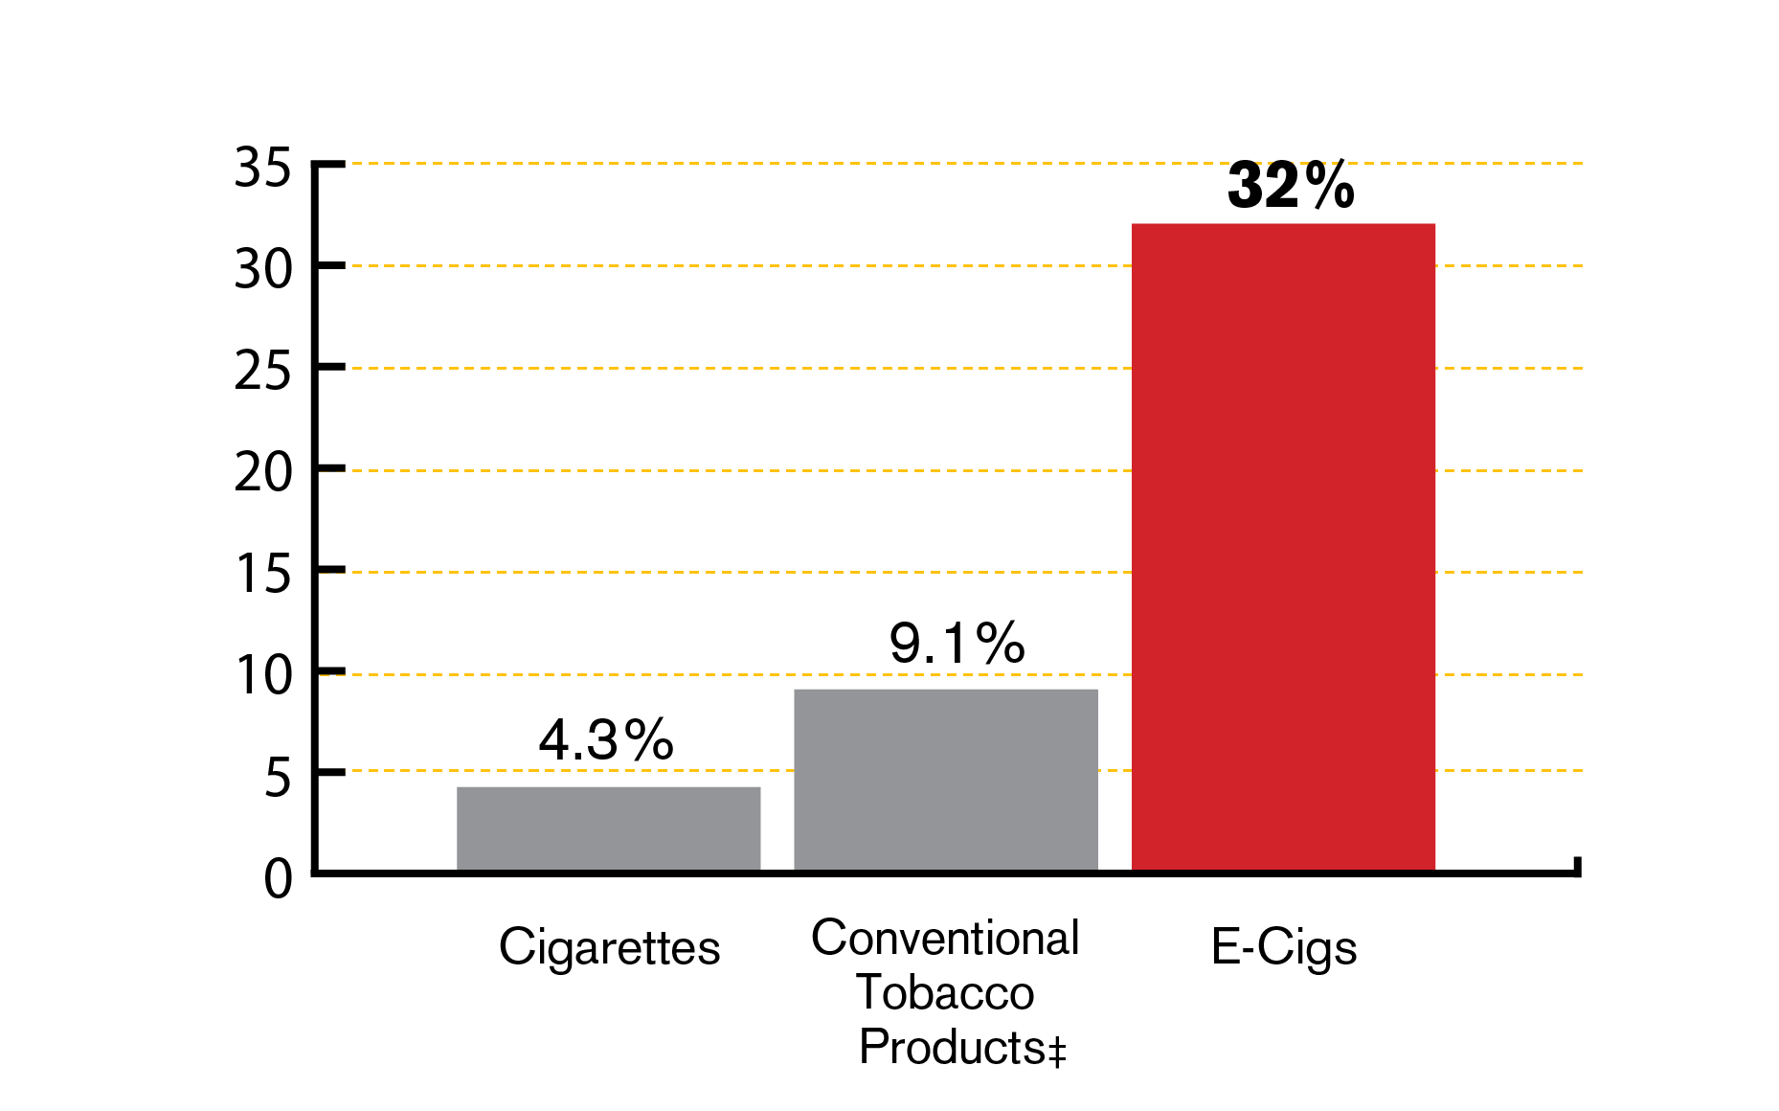
Youth use of vaping products - HS
In 2019 51.2% of MA high school youth had ever used e-cigarettes.
Current use of e-cigarettes by high school youth was higher than use of any other tobacco products combined.
Current† Use of Tobacco and Vaping Products by MA High School Youth, 2019
† Use in the past 30 days
‡ Conventional tobacco defined as cigarettes, cigars (including little cigars and cigarillos), and smokeless tobacco (chewing tobacco, snuff, dip)
Source: 2019 MA Youth Health Survey. Data are provisional
Notes:
Source: 2019 MA YHS.
For schools: If your district or school has data from a local survey or a Youth Risk Behavior Survey (YRBS) you can include that information along with (or instead of) the state data on this slide.
Talking Points:
Young people are using these products more than any other tobacco product (read slide aloud)
In 2019, e-cigarette use among high school youth was significantly higher than that of adults.

Slide 7
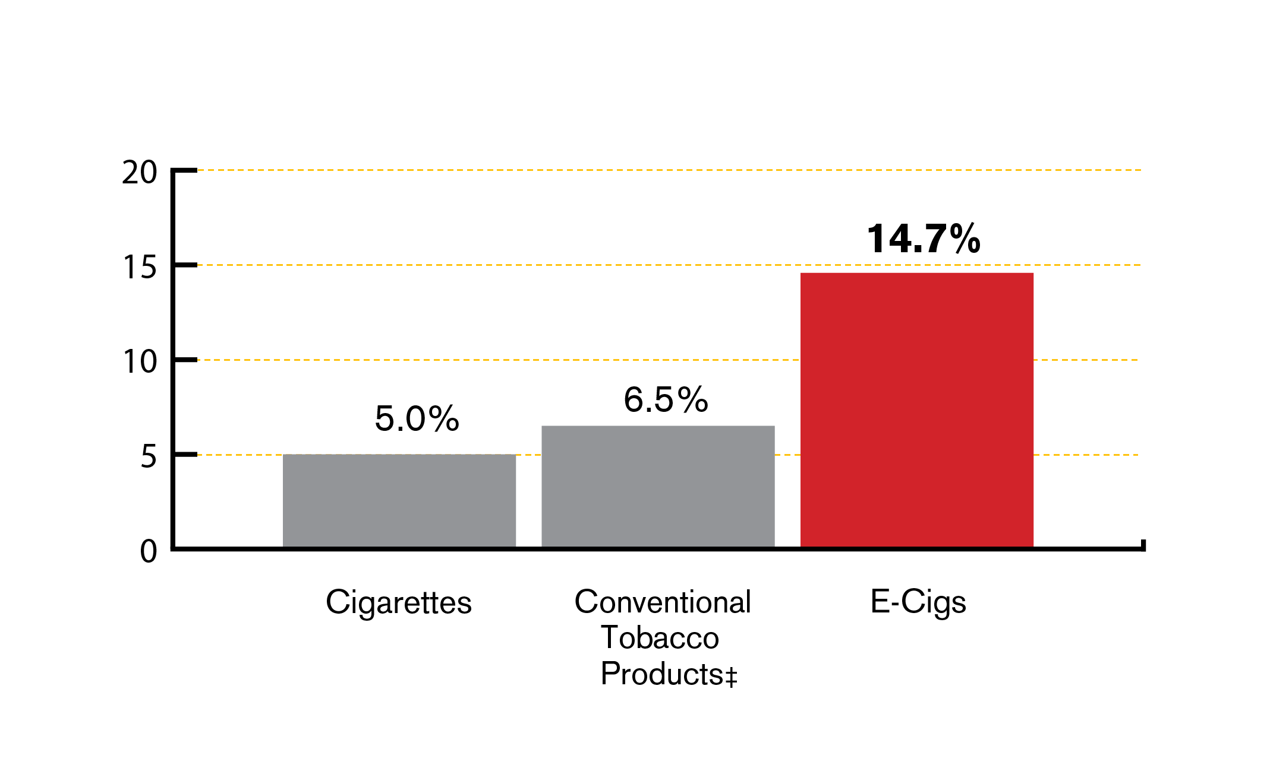
Youth use of vaping products - MS
Ever Use of Tobacco Products
Among MA Middle School Students, 2019
In 2019 14.7 % of MA middle school youth had ever used
e-cigarettes.
‡ Conventional tobacco is defined as cigarettes, cigars (including little cigars and cigarillos), and smokeless tobacco (chewing tobacco, snuff, dip)
Source: 2019 MA Youth Health Survey. Data is provisional.
Notes:
Source: 2019 MA YHS
For schools: If your district or school has data from a local survey or a Youth Risk Behavior Survey (YRBS) you can include that information along with (or instead of) the state data on this slide.
Talking Points:
Nearly 15% (14.7%) of middle school youth had tried e-cigarettes.

Slide 8
Nicotine
Vaping products and e-cigarettes contain nicotine—a highly addictive substance
We can’t be sure what is in these products or how much nicotine they contain
Notes:
Talking Points:
Vaping devices and e-cigarettes contain nicotine. Nicotine is highly addictive.
The Food and Drug Administration’s (FDA) Center for Tobacco Products has the authority to regulate the manufacture, import, packaging, labeling, advertising, promotion, sale, and distribution of electronic nicotine delivery systems. The FDA does not have authority to regulate vaping accessories.
The FDA has delayed using its regulatory authority over other areas of e-cigarettes, including the manufacture of e-liquids. Without manufacturing regulations, people can’t be sure what is in these products. (Note: This is continually evolving)

Slide 9
Nicotine
Nicotine damages the developing adolescent brain
Nicotine can prime the adolescent brain for addiction to other substances
Youth who use e-cigarettes are more likely to become traditional cigarette smokers¹
People who start smoking or using tobacco products in adolescence, smoke more and have a harder time quitting than people who start as adults²
Notes:
Talking Points:
According to the Centers for Disease Control and Prevention (CDC), e-cigarettes are not safe for youth, young adults, pregnant women, or adults who do not currently use tobacco products.
According to the Surgeon General, because the brain isn't fully developed until the mid 20s, youth and young adults are uniquely at risk for long-term, long-lasting effects of exposing their developing brains to nicotine.
Risks include: nicotine addiction, mood disorders, and permanent lowering of impulse control. Nicotine also changes the way synapses are formed, which can harm the parts of the brain that control attention and learning.
Nicotine can also prime the adolescent brain for addiction to other substances.
E-cigarette use among youth and young adults is strongly linked to the use of other tobacco products such as regular cigarettes, cigars, hookah, and smokeless tobacco.
Due to changes in the brain, quitting is harder for those who start at a young age. Prevention is key.
References:
1. Surgeon General’s Know the Risks: https://e-cigarettes.surgeongeneral.gov/knowtherisks.html
2. Many published studies have shown this, including: Abreu-Villaca, Y. et al (2003). Short-term adolescent nicotine exposure has immediate and persistent effects on cholinergic systems: Critical periods, patterns of exposure, dose thresholds. Neuropsychopharmacology, 28 pp. 1935-1949

Slide 10
Tobacco and Vaping Industries
The industries target youth with sweet, cheap, and easy to get products.

Slide 11
Industry tactics
Source: National Youth Tobacco Survey, 2011-2014; Kim et al (2014), Truth Initiative (2015)
Notes:
Talking Points:
The tobacco and vaping industries spends millions of dollars targeting youth.
They want to get youth hooked to make them lifelong customers.
In this graph you can see how as e-cigarette advertising increases, so does youth use!

Slide 12
Industry tactics
The tobacco and vaping industries target young people by making their products:
Sweet
Cheap
Easy to Get
Notes:
Talking Points:
The tobacco industry has a history of targeting groups of people to make them new customers. This is nothing new – the tobacco and vaping industries are using the same tactics with these new and emerging products.
They’re targeting kids with products that are sweet, cheap, and easy to get.

Slide 13
Sweet
E-liquids and juices contain flavorings
Thousands of sweet and fruity flavors to pick from (chocolate, cotton candy, fruit punch, mango…)
Flavors appeal to youth
Flavors may make vaping seem harmless
Notes:
Talking Points:
The first tactic is sweet.
According to the FDA (Food and Drug Administration), flavored tobacco products appeal to youth. Tobacco industry documents show that companies designed flavored cigarettes with kids in mind. That’s why the FDA made it illegal to sell flavored cigarettes (except for menthol) in 2009. But that action excluded other tobacco products such as cigars, chewing tobacco or other emerging products such as e-cigarettes.
E-cigarettes contain pre-filled pods or e-liquids/e-juices the user adds to the device. E-liquids generally consist of propylene glycol, glycerin, water, nicotine, and flavorings. Many of these pods and e-liquids come in fruit and candy flavors that appeal to youth.
E-liquids come in flavors such as chocolate, cotton candy, fruit punch, etc.
There are thousands of flavors to pick from.

Slide 14
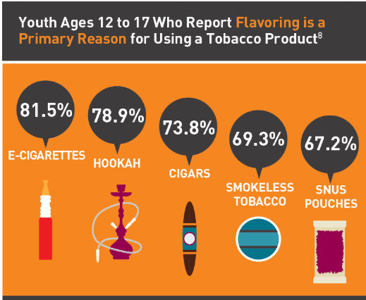
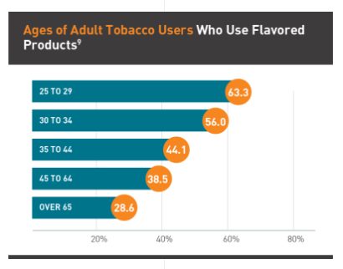
Sweet – Do flavors appeal to adults?
Younger people are more likely to use flavored products than older adults
Source: Truth Initiative, truthinitiative.org/news/flavored-tobacco-use-among-youth-and-young-adults
Notes:
Talking Points:
In the U.S., more than four out of five young adults ages 18 to 24 who have ever used tobacco reported that their first product was flavored.
Flavored tobacco product use is higher in younger adults than in older adults. Nearly three-quarters of young adult current tobacco users report flavored tobacco use, compared to just 28.6 percent of adults over 65.
National data found on: https://truthinitiative.org/news/flavored-tobacco-use-among-youth-and-young-adults

Slide 15
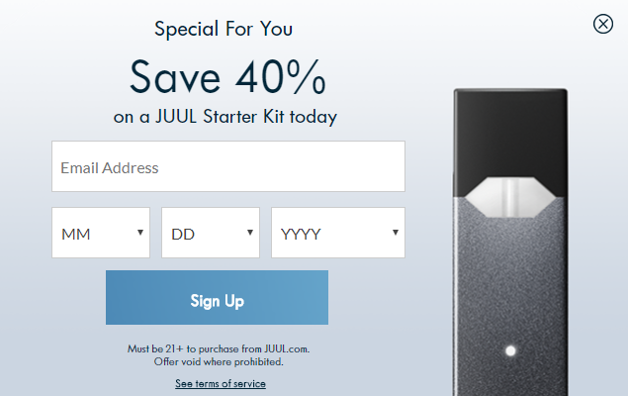
Cheap
Products are often inexpensive—special offers and coupon codes make them cheap
Low prices create impulse buys
Notes:
Talking Points:
The industries use low prices, coupons, and sales or specials to make their products cheap.
Sometimes the starter kits seem costly at first, but the pods that deliver nicotine are competitively priced with other tobacco products.
Youth are more likely to buy when the price is low, and less likely to buy when it is high. This is why youth cigarette smoking has dropped in the past when there have been tax increases.*
*Chaloupka, F., “Macro-Social Influences: The Effects of Prices and Tobacco Control Policies on the Demand for Tobacco Products," Nicotine and Tobacco Research, 1999; and others.
Other tobacco products such as flavored cigars can often be found at inexpensive prices.
Anecdotally, we hear that youth may share a device or pods/e-juices to cut down on the cost.
Some cities and towns across Massachusetts have local policies in place to restrict the sale of cheap, single cigars. The policy sets a minimum price and package size for cigars. (Note: Does your city/town have this policy in place? To find out, contact your local board of health.)

Slide 16
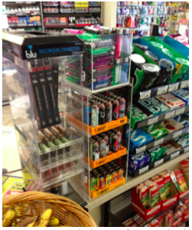
Easy to get
Vaping products have been everywhere—corner stores, gas stations, vape shops, online
Availability sends the message that these products are normal and fine
The more youth see them, the more likely they are to buy and use
Notes:
Talking Points:
Until very recently, E-cigarettes were sold in many places including convenience stores, corner stores, gas stations, vape shops, and online. And, flavored products were often found on counter tops, or next to candy displays, where they were visible and easily accessible to youth.
Just like other tobacco and nicotine products, youth may get e-cigarettes from friends who vape or from local or online stores that do not abide by Massachusetts’ restrictions on sales,. If you wish to report one of these sales violations, call 1-800-992-1895 or contact your local Board of Health.
This availability sends the message that these products are normal and fine – and availability leads to impulse buys.
The more you see them, the more likely you are to buy them.
Research shows that kids who shop at stores with tobacco two or more times a week are 64% more likely to start smoking than their peers who don’t.*
(*Henriksen, Schleicher, Feighery and Fortmann. A Longitudinal Study of Exposure to Retail Cigarette Advertising and Smoking Initiation. Pediatrics: The Official Journal of the American Academy of Pediatrics. July 19, 2010, DOI: 10.1542/peds.2009 3021)
Governor Baker signed legislation in 2018 that prohibits the sale of tobacco products by any pharmacy, hospital, or other entity that offers health care services or that employs any licensed health care providers – as of December 31, 2018 tobacco was no longer available in your local pharmacy.
And the next slide provides information An Act Modernizing Tobacco Control, which is changing the look of the tobacco retail environment for our youth.

Slide 17
Massachusetts has taken action to reduce the influence of the tobacco and vaping industries
SWEET: The sale of flavored e-cigarettes is now restricted to adult-only smoking bars. As of June 2020, ALL flavored tobacco products, including menthol, are restricted to smoking bars for onsite consumption only.
CHEAP: As of June 2020, e-cigarettes and other electronic nicotine delivery systems will be taxed, bringing them in line with the cost of cigarettes and other tobacco products and making them less attractive for impulse buys.
EASY to GET: The new law in Massachusetts makes e-cigarettes and all other flavored tobacco products harder to get. But this doesn’t mean that youth will stop seeing tobacco products or advertisements in your community.
Notes:
On December 11, 2019, the state’s Public Health Council approved new regulations that restrict the sale of nicotine vaping and flavored vaping and tobacco products. This action follows the Legislature passing and Governor Charlie Baker signing into law An Act Modernizing Tobacco Control, which provided the Massachusetts Department of Public Health with additional authority to regulate access to tobacco and electronic nicotine delivery systems, including vapes.

Slide 18
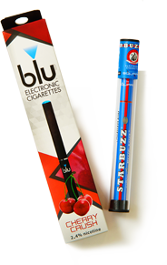
Vaping 101
What do they look like? Is it just water vapor?

Slide 19
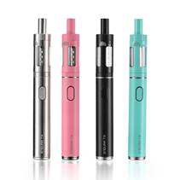
What is vaping?
Inhaling and exhaling the aerosol (often called vapor) produced by an e-cigarette or similar battery-powered device
Called e-cigs, vape pens, e-hookahs, e-pipes, tanks, mods, vapes, electronic nicotine delivery systems, or ENDS, and more
Sometimes referred to by brand names such as JUUL (Juuling), BO, Blue, and others
Notes:
Talking Points:
What is vaping? Vaping is the act of inhaling and exhaling the aerosol (often called vapor) produced by an e-cigarette or similar battery-powered device.
What is an e-cigarette? E-cigarettes are battery-powered vaporizers that simulate the action and sensation of smoking.
What are other names for e-cigarettes? They are also known as e-cigs, vape pens, e-hookahs, e-pipes, tanks, mods, vapes, electronic nicotine delivery systems, or ENDS, and more. Some people refer to vaping devices by their brand name such as JUUL, BO, Blu, and others.

Slide 20
Vapor vs. Aerosol
Produces an aerosol, NOT water vapor
Aerosol can contain harmful substances:
Nicotine
Ultrafine particles that can be inhaled deep into the lungs
Flavoring such as diacetyl, a chemical linked to a serious lung disease
Volatile organic compounds
Cancer-causing chemicals
Heavy metals such as nickel, tin, and lead
Notes:
Talking Points:
E-cigarettes contain pre-filled pods or e-liquids/e-juices the user adds to the device. E-liquids generally consist of propylene glycol, glycerin, water, nicotine, and flavorings. Many of these pods and e-liquids come in fruit and candy flavors that appeal to youth.
E-cigarettes produce an aerosol, commonly called vapor, which users inhale from the device and exhale. The aerosol can contain harmful and potentially harmful substances, including:
Nicotine
Ultrafine particles that can be inhaled deep into the lungs
Flavoring such as diacetyl, a chemical linked to a serious lung disease
Volatile organic compounds
Cancer-causing chemicals
Heavy metals such as nickel, tin, and lead

Slide 21
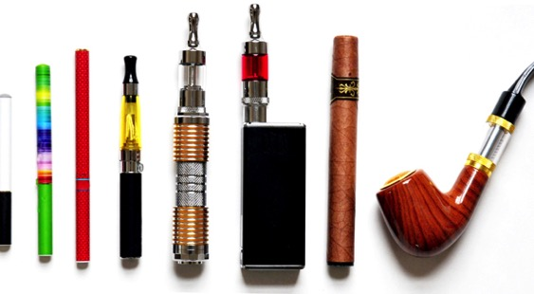
The New Look of Nicotine Addiction
Notes:
Talking Points:
E-cigarettes come in many different sizes, types, and colors.
Some e-cigarettes are made to look like regular cigarettes, cigars, or pipes. Some resemble pens, small electronic devices such as USB sticks, and other everyday items. The products that are designed to resemble small electronic devices are often compact and allow for discreet carrying and use—at home, in school hallways and bathrooms, and even in classrooms.

Slide 22
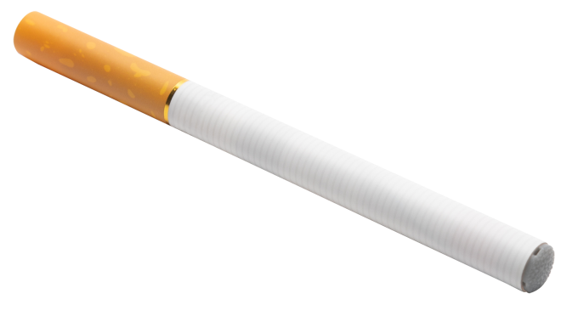
Types of products
Rechargeable E-cigarettes (JUUL, myblu, and Bo)
Disposable E-cigarettes
Notes:
Talking Points:
Rechargeable e-cigarettes often look like small electronic devices such as a USB stick. Common brand names are JUUL, Bo, and myblu. They frequently are sold with pre-filled cartridges or pods.
Disposable e-cigarettes often appear like actual, filter cigarettes in both shape and coloring. Common brand names include Zig Zag, Vapor4Life, V2, and White Cloud.
It is helpful to note that many types of e-cigarettes are rechargeable, except for disposable e-cigarettes which are disposed of after the initial charge of the battery is depleted.

Slide 23
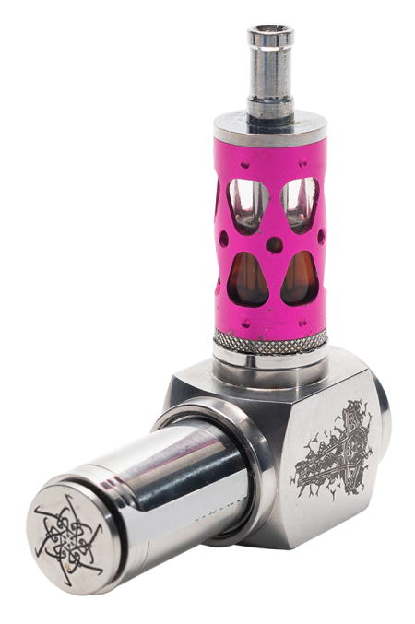
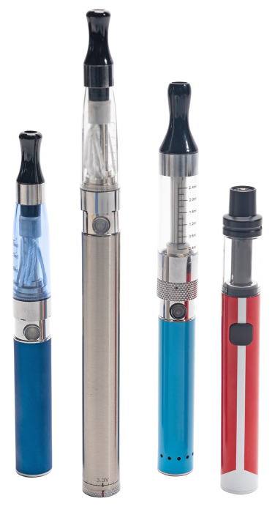
Tank Systems
Vape Pens
Notes:
Talking Points:
Tank systems come in medium- to large-size devices that bear little or no resemblance to other tobacco products. They come in disposable and “rebuildable” versions, under brand names such as Aspire, Smok, Vaporesso, and Kangertech
Medium-sized tank vaping devices are commonly referred to as vape pens. They are generally more compact than other vape devices and are relatively easy to conceal. Pens have often been used discreetly by youth at school and home. Common pen brands include JUUL, Aspire, Apollo, and Kanger among others.

Slide 24
E-liquids and E-Juices
Pods
Notes:
Talking Points:
As we talked about under the tactic of “sweet,” E-cigarettes and other vaping devices are considered either open or closed systems. In open systems, the user adds the e-liquid (commonly referred to as e-juice). In closed systems, the user uses pre-filled cartridges or pods. The vaping devices convert the e-liquids into an inhalable aerosol.
E-liquids/juices come in thousands of flavors including chocolate, cotton candy, fruit punch, gummi bear, banana, peach, lime, and many others. Flavors are often cited as the main reason youth try these products.

Slide 25
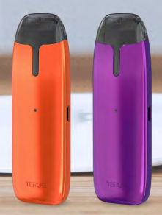
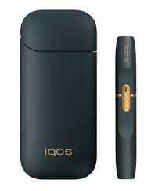
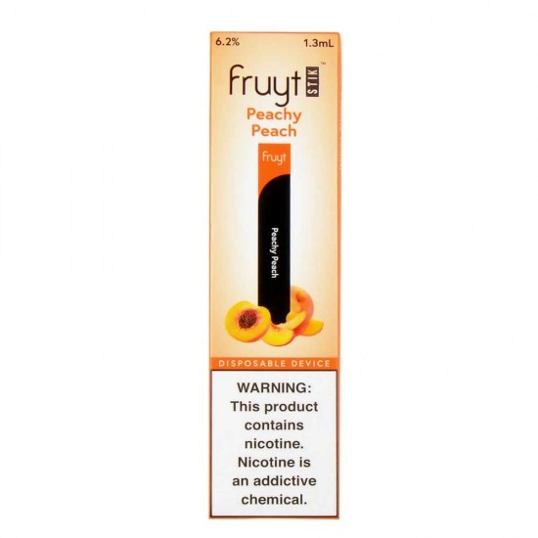
New and emerging products
Notes:
Talking Points:
Tobacco and vaping companies appear to be introducing many new types of e-cigarettes that are sleek, concealable, and modern.
Some vendors state that they can’t keep up with the volume of new e-cigarette products.
Major tobacco companies and independent companies are producing these types of e-cigarettes.
Many of the new e-cigarettes closely resemble the design features of JUUL. In addition to the JUUL style that look like a USB stick, new concealable e-cigarettes have been introduced in additional shapes.
Companies are also now introducing pre-charged, completely disposable e-cigarettes. (From Campaign for Tobacco-Free Kids)
IQOS is a newer product with “heat, not burn” technology.

Slide 26
How it works
Notes:
Talking Points:
E-cigarettes create an aerosol by using a battery to heat up liquid that usually contains nicotine, flavorings, and other additives. Users inhale this aerosol into their lungs. E-cigarettes can also be used to deliver cannabinoids such as marijuana, and other drugs.
Image and language pulled from: https://e-cigarettes.surgeongeneral.gov/getthefacts.html

Slide 27
Can e-cigarettes be used to vape other substances?
Yes!
Open systems require the user to add the e-juice, which can be a substance other than nicotine.
Closed systems (those that use pre-filled pods) can also be altered to vape substances other than nicotine.
Notes:
Talking Points:
Many people specifically ask if e-cigarettes can be used to vape marijuana. The answer is yes.
Marijuana can be vaped in open systems, that require the user to add the e-juice
Closed systems (those that use pre-filled pods) can also be altered to vape substances other than nicotine.

Slide 28
Are e-cigarettes safe?
E-cigarettes are not safe for youth, young adults, pregnant women, or adults who do not currently use tobacco products (CDC)
Contains nicotine and other chemicals
More research is needed to understand the long-term health effects
EVALI or other lung issues
Secondhand vape is also unsafe
Other dangers
Notes:
Talking Points:
According to the Centers for Disease Control and Prevention, e-cigarettes are not safe for youth, young adults, pregnant women, or adults who do not currently use tobacco products. E-cigarettes have not been approved by the FDA as a smoking cessation device and additional research is needed to help understand long-term health effects of e-cigarette use.
As of the publication of this presentation (February 2020), the Centers for Disease Control and Prevention and the Food and Drug Administration are investigating the cause of e-cigarette, or vaping, product use associated lung injury (EVALI). For updated information on the lung injury associated with vaping, visit the CDC’s website on the topic at http://bit.ly/2s5Hiz0. There can be serious lung issues due to e-cigarette use that are not officially diagnosed as EVALI.
Secondhand vape - According the Surgeon General, the aerosol from e-cigarettes is not harmless. It can contain harmful and potentially harmful chemicals, including nicotine; ultrafine particles that can be inhaled deep into the lungs; flavoring such diacetyl, a chemical linked to a serious lung disease; volatile organic compounds such as benzene, which is found in car exhaust; and heavy metals, such as nickel, tin, and lead.
Other Harms
Due to nicotine content, e-liquids are dangerous to small children and pets. The Massachusetts Attorney General requires that nicotine liquid and gel be sold in appropriate child-resistant packaging.
Defective e-cigarette batteries have caused fires and explosions, some of which have resulted in serious injuries.

Slide 29
How do we know if our students are vaping?
Unexplained Sweet Scent – might be a flavored e-juice for a vaping device
Unfamiliar Products – If you come across unusual pens or USB drives or an unfamiliar battery or battery charging device, they could be associated with vaping
Notes:
For community based organizations: You can replace the phrase “our students” with a more appropriate phrase for your organization or program.
Talking Points:
You might also observe signs of nicotine addiction, which could include leaving the class frequently (students feeling a need to use nicotine) and symptoms of withdrawal when they have gone long periods without vaping such anxiety, irritability, restlessness, difficulty concentrating, depressed mood, frustration, and anger (source: Mayo Clinic))

Slide 30
Vaping POLICIES AND PROCEDURES
What are our policies and procedures?
Notes:
Talking Points:
What are the policies and procedures our school/organization has in place to address vaping?

Slide 31
State laws
The Massachusetts Smoke-Free Workplace Law
The “Education Reform Act”
An Act Modernizing Tobacco Control
Notes:
Talking Points:
The Massachusetts Smoke-Free Workplace Law prohibits smoking in all enclosed workplaces, including public and private schools.
In addition, Massachusetts requires that all public schools through high school prohibit smoking on school grounds, on school buses, and at school sponsored events during normal school hours. The law is commonly referred to as the “Education Reform Act” (MG.L. ch. 270, §22(b)(2); MGL c. 71, §§2A, 37H; c. 90, §7B(10)). Governor Baker signed legislation that amends the Education Reform Act to include e-cigarettes and other electronic nicotine delivery products. This took effect December 31, 2018.
Schools also create their own policies with regard to tobacco use on school property for students, staff and visitors.
On December 11, 2019, the state’s Public Health Council approved new regulations that restrict the sale of nicotine vaping and flavored vaping and tobacco products. This action follows the Legislature passing and Governor Charlie Baker signing into law An Act Modernizing Tobacco Control, which provided the Massachusetts Department of Public Health with additional authority to regulate access to tobacco and electronic nicotine delivery systems, including vapes.
The new law places the following restrictions:
Retail stores licensed to sell tobacco products, such as convenience stores, gas stations, and other retail outlets, are restricted to the sale of non-flavored nicotine products with a nicotine content of 35 milligrams per milliliter or less.
The sale of non-flavored nicotine vaping products (with a nicotine content over 35 milligrams per milliliter) is restricted to licensed, adult-only retail tobacco stores and smoking bars.
The sale and consumption of all flavored nicotine vaping products may only occur within licensed smoking bars.
Beginning June 1, 2020, the sale of flavored combustible cigarettes and other tobacco products, including menthol cigarettes and flavored chewing tobacco, will be restricted to licensed smoking bars where they may be sold only for on-site consumption. Also taking effect on June 1st is the addition of a 75 percent excise tax on the wholesale price of nicotine vaping products, in addition to the state’s 6.25 percent sales tax.

Slide 32
Our policies about vaping
Insert District or School policies regarding vaping or organization’s vaping policies
For students/participants
For staff
Notes:
Insert your own policies about vaping on this slide. Add consecutive slides for more information, if necessary.
Please see the Guidance document for suggested topics for this section.

Slide 33
Our procedures
Insert school/organization procedures
What to do if you see a student/participant with a vaping device
What to do if you see a student/participant vaping
Role of School Resource Officer
Resources available to students/participants
Notes:
Insert your own procedures about vaping on this slide. For schools, if the School Resource Officer has a role or can provide resources, talk about it here. Community Based organizations can take out this point.
On this slide you can also mention resources available to students/participants for assistance with tobacco/nicotine addiction or simply for questions/concerns about vaping in the school/organization.
Please see the Guidance document for suggested topics for this section.

Slide 34
WHAT We CAN DO
How can we make a difference?

Slide 35
What we can do
Educate ourselves – be aware of what these products look like, what they might smell like, etc.
Educate our youth!
Know the policies and procedures
The 84 Movement
Connect youth with resources to quit
Notes:
Note: If your school/organization is doing something to address youth use of e-cigarettes (for example implementing the CATCH curriculum), it can be addressed on this slide.
Talking Points:
The most important place to start is to educate ourselves – be aware of what these products look like, what they might smell like, etc. It is important to note that this presentation covered products that are currently on the market – there likely will be new and emerging products from the tobacco and vaping industries. We need to keep our eyes and ears open and make one another aware if we see our students/participants with new products.
And we can educate our youth! We’ll talk about a campaign from the Massachusetts Department of Public Health that seeks to raise awareness among youth about the dangers of vaping.
And now that we know that the tobacco and vaping industries use the tactics of making their products sweet, cheap and easy to get (available everywhere), we can be more aware of what is sold in the stores near our home, organization or school.
Know the state laws regarding the use of these products on school grounds.
Know the policies and procedures of our district/school/organization with regard to e-cigarettes and other vaping devices.
The 84 Movement - Hundreds of high school students across Massachusetts take part in this youth initiative that empowers young people to work for change in their own communities. You can visit www.the84.org for more information.
Note: If your school/organization does not have an 84 Chapter, perhaps a “Next Step” could be to consider establishing one. For parents, if an 84 Chapter is at school or a local community based organization, encourage your child to check it out.
Note: For parents – there are other things that parents can do. As mentioned during the tobacco/vaping industry tactics slides, there are local tobacco policies that can have an impact on what/where and how tobacco products are sold in your community. Visit makesmokinghistory.org under “My Community” to find out what tobacco policies are in place in your community. You can also contact your local Board of Health.

Slide 36
Vapes and Cigarettes: Different Products. Same Dangers.
Notes:
Talking Points:
Vapes and Cigarettes: Different Products. Same Dangers is a public information campaign from the Department of Public Health (DPH) to raise awareness among middle and high school aged youth about the dangers of vaping. As you can see, it makes the connection between vaping/using e-cigarettes and smoking combustible cigarettes.
During the development of this campaign, DPH discovered that although youth know smoking is dangerous for their health, they don’t see vaping as having the same dangers for them. The brackets on the poster show that both products can cause addiction, and both have nicotine and cancer-causing chemicals.
In addition, the four facts on the bottom of the poster provide information that young people might not know about vaping –
Some vape pods have as much nicotine as 20 cigarettes (a pack)
It’s not water vapor – aerosol from vaping has cancer causing chemicals
Nicotine can harm your brain, including your memory and ability to learn
If you vape, you are 4x more likely to smoke cigarettes

Slide 37
Vapes and Cigarettes: Different Products. Same Dangers.
Ads reach youth online and through social media
(April – June 2019 and again October 2019– February 2020)
Materials for schools and community based organizations
including updates to the Toolkit on GetOutraged.org with ideas for using the campaign materials
Call to action to youth to visit www.mass.gov/vaping and follow Instagram account @GetTheVapeFacts
Notes:
Notes: Let the audience know how your school/organization will utilize the campaign materials.
For staff: This could be a good opportunity for discussion about incorporating the materials and messages into lesson plans, activities, etc.
For parents: Also discussed in a later slide, encourage parents to use the campaign as an opportunity to educate themselves about vaping as well as a conversation starter with their child(ren) about the topic.
Materials for schools include the poster on the previous slide, and mirror clings – the four facts at the bottom of the poster are printed individually and are available to hang on mirrors, windows, doors, etc. A handout of other facts and resources for youth (also found on www.mass.gov/vaping) is also available.
The Toolkit on GetOutraged.org is updated with information about the campaign and ideas for schools/community based organizations to use the campaign’s materials.
The campaign’s posters and materials do have a place for teens to go if they choose to seek additional information and resources. www.mass.gov/vaping as well as an Instagram account, which will have facts as well as paid ads using the campaign’s images.

Slide 38
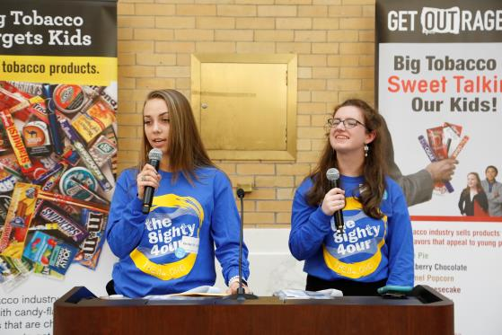
The84
The 84 is a statewide movement of youth fighting tobacco in MA.
Formed through local organizations or high schools.
Youth educate peers and community members about the influence of the tobacco and vaping industries.
Participate in Kick Butts Day, an annual event at the MA State House.
Notes:
Talking Points:
The 84 is a statewide movement of youth fighting tobacco in Massachusetts.
The 84 represents the 84% of Massachusetts youth who did NOT smoke when the movement began. Now, 92% of youth do NOT smoke.
Youth groups in a high school or community organization who want to fight against Big Tobacco sign up to become an 84 Chapter and be a part of the movement.
What do The 84 Chapters do?
Educate their peers and adults about the tobacco industry’s marketing tactics
Help to create change locally and statewide to reduce the influence of tobacco in their communities
Survey youth and adults about their perception of the prices and availability of other tobacco products
Promote social norms messaging around youth tobacco use
Annually, The 84 Chapters actively engage in important tobacco prevention events.
More information can be found at https://the84.org/ or by talking to your local Tobacco-Free Community Partnership.

Slide 39
Talk with youth as a trusted adult
Provide them with facts about vaping
E-cigarettes contain nicotine
Dispel the myths
It is not harmless water vapor
Tell them the tobacco and vaping industries are targeting them to make money and hook them on their products
Ask them what they see and what they think
Have they seen the Vapes and Cigarettes. Different Products. Same Dangers. ads or materials? Use this as a conversation starter.
Notes:
The Vapes and Cigarettes. Different Products. Same Dangers information can be used as a conversation starter about vaping/e-cigarettes.

Slide 40
Talk with your kids
Be patient and ready to listen
No “perfect time” to talk
Ask your child what they think
Be open and honest
Are you a tobacco user?
Just talking can protect them!
Notes:
This slide is most relevant for a parent presentation
Talking Points:
Talking with your kids about vaping is one of the most important things you can do. Below are tips to help you prepare for and start the conversation.
Be patient and ready to listen. Your goal is to have a conversation, not to deliver a lecture. So avoid criticism and encourage an open dialogue.
There is no “perfect time” to talk. Driving in the car together or waiting at an appointment is often the best time. You can start by mentioning a news story, a TV show, or something that you heard about vaping. Or ask your child what he or she thinks about a situation you witness together such as seeing someone use an e-cigarette, passing a vape shop when you are out, or seeing an e-cigarette advertisement.
There is no “perfect talk.” Consider your talks with your child about vaping as a learning opportunity for both of you, and perhaps just the beginning of an ongoing dialogue. You may have some facts about vaping at hand, but concede that you don’t know all the answers. It will go a long way to keep your kids from going on the defensive.
Ask what your child thinks. Show some genuine curiosity. Ask your child, “What’s your take on vaping?” or “Do you know kids who use e-cigarettes?”
Be open and honest. Be truthful about what you know about the dangers of vaping, and what you don’t. You can honestly say, though, “Vaping isn’t harmless. I hope you can steer clear of it.”
You can’t always control everything your children do when they’re not with you. Talking with your kids about vaping will let them know that you’re concerned about their health.
Are you a tobacco user? Be honest and talk with your child about your choices and how hard it is/was to quit.
If you need help quitting tobacco, it’s never too late to keep trying. Call 1-800-QUIT-NOW or visit makesmokinghistory.org for information and support.

Slide 41
Helping Youth Quit
This is Quitting powered by truth®
Automated text program
Text “VapeFreeMass” to 88709
My Life, My Quit TM
Youth coach specialists
Support via phone, text or chat
Call or text "Start My Quit" to 855-891-9989
Teen.smokefree.gov
Encourage young people to ask a trusted adult for help such as their school nurse or counselor, athletic coach, doctor, or parent.
Notes:
This is Quitting powered by truth® is a free and confidential texting program for young people who vape. Young people can text “VapeFreeMass” to 88709 to get started.
My Life, My Quit TM has youth coach specialists trained to help young people by phone or text. Call or text "Start My Quit" to 855-891-9989 for free and confidential help. For more information or to sign up online, visit mylifemyquit.com. (or: My Life, My Quit TM has youth coach specialists trained to help young people by phone or text. Young people can call or text "Start My Quit" to 855-891-9989 for free and confidential help or visit mylifemyquit.com to sign up online.)
Visit teen.smokefree.gov for tools and tips .
Encourage young people to ask their school nurse or counselor, athletic coach, doctor, parent or other trusted adult for help.
For more information, young people can visit mass.gov/vaping.
More information for parents/adults is available at GetOutraged.org.

Slide 42
Questions / discussion
Notes:
This is at time for questions/discussion. This section can be moved to a different location in the presentation, if desired. If you do move this section, be sure to adjust the table of contents accordingly.

Slide 43
Next Steps
What now?

Slide 44
Next steps
Insert group next steps here
Notes:
If there are any “next steps” for your district/school or organization in terms of policies or procedures around vaping, list those here.
Additional opportunities for trainings can also be listed here, including any meetings/presentations you might be holding for other audiences. For example, if this is a presentation for staff, you can let staff know when there will be a presentation for parents.
Please see the Guidance document for suggested topics for this section.

Slide 45
ADDITIONAL RESOURCES
For more information

Slide 46
Additional Resources
www.GetOutraged.org
Facts
For parents (tips on talking with your kids)
For schools
Toolkit divided into information for Administrators (this presentation!); teachers; school health services; healthcare providers
Resources to help youth quit
En Español (select sections available in Spanish)
www.mass.gov/vaping
Simple information on vaping and quitting resources for youth
Massachusetts Health Promotion Clearinghouse
Print materials
Notes:
Please see the Guidance document for suggested topics for this section.
Talking Points:
Visit the Massachusetts Department of Public Health’s website focused on this vaping problem at www.GetOutraged.org. You can get the facts on vaping and other tobacco products, as well as information for parents and for schools! There is a toolkit for schools and organizations to use to help address this issue, including this PowerPoint.
There is also the Massachusetts Health Promotion Clearinghouse found at www.mass.gov/maclearinghouse. This site has free printed materials to download or order to help spread the word. Much of the content on the GetOutraged.org website is available in print form at the Clearinghouse.

Slide 47
Notes:
Thank your participants for coming. In place of this slide, you can insert a slide with contact information or other information as needed.

